Slide 1
PREDICTING THE ENERGY OUTPUT OF THE WIND TURBINE BASED ON WEATHER CONDITION
MUTHU KUMAR T GANESH KUMAR V VIGNESH U

Slide 2
ABSTRACT
The idea is to build a Web Application for the wind farm, to predict the output of wind energy for efficient energy production.
Due to less wind flow and climate changes the amount of energy production was minimum.
This model obtained for energy prediction gives a very efficient and reliable prediction of the energy output.

Slide 3
PURPOSE
The production of wind energy is hard to predict as it relies on the rather unstable weather condition present at the wind farm.
There is no that much amount of storage place to store the energy.
Due to this problem the wind turbine should be stopped for some time.
To avoid these problem energy production should be predicted. If the output energy predicted, then we can collaborate energy suppliers to produce the constant amount of energy in all duration.

Slide 4
PROPOSED SYSTEM
For predicting the energy production of wind farms , we collect dataset resource from the wind farm.
The collected data were preprocessed, it consists of tasks like removing null values, removing duplicate data.
The proposed solution is to provide a time series model to Predict the power output of a wind farm based on the weather condition in the site (1Hr prediction to 72Hrs. prediction).
The machine learning models are used to predict weather conditions.
The result is visualized to the energy suppliers and end users via a website dashboard.

Slide 5
PROCESSING STEPS
Data collected from wind farm
Preprocessing Data
-This Process consists of data cleaning, data analysis and feature engineering.
Model Development
UI/Dashboard Development

Slide 6
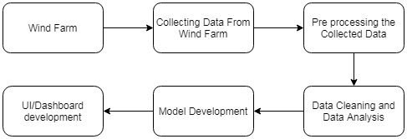
Block Diagram

Slide 7
TECHNOLOGY STACK
The below libraries and tools are used for this development process.
1. Model Development :
Tensorflow
Keras
Pandas
Matplotlib
Numpy
Sklearn

Slide 8
TECHNOLOGY STACK
2.UI Development:
HTML
CSS
JAVASCRIPT
DJANGO

Slide 9
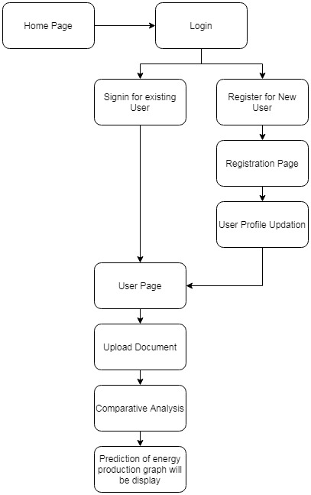
FLOW CHART

Slide 10
MODEL DEVELOPMENT
To create a time series model we are going to use Recurrent Neural Network. Because RNNs process a time series step-by-step, maintaining an internal state summarizing the information they've seen so far. For layers in RNN we will use Long Short Term Memory(LSTM).

Slide 11
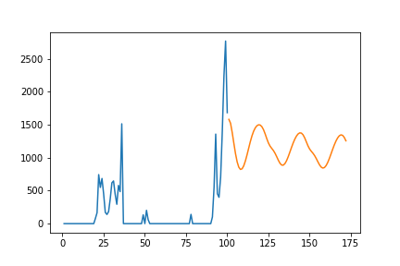
PREDICTED OUPUT

Slide 12
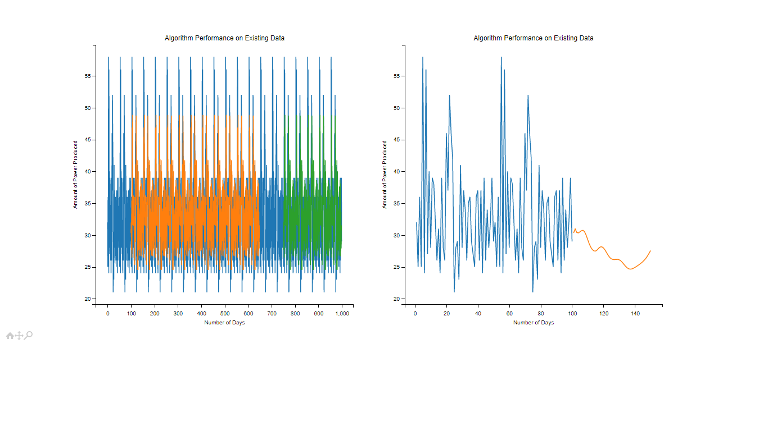
RESULT

Slide 13
CONCLUSIONS
The Application has been developed and ready for the implementation. This system will provide the best solution for high energy production of the wind farms.
It has been found that by monitoring the data from the wind farms such as time, wind direction, wind speed, theoretical power, active power.
It selects the selected wind farms which produces comparatively higher energy production than all the other wind farm.
The dashboard clearly shows the energy production of the individual wind farms.

Slide 14
THANK YOU

